Slide 1
Customer Satisfaction analysis
Analysis to increase the satisfaction ratings of customers of an Airline using R

Slide 2
Business Questions
Which variables influence the satisfaction in the airline industry?
How do these variables affect the satisfaction ratings for Cheapseats Airlines?
What can be suggested in order to increase the satisfaction for each of these variables?

Slide 3
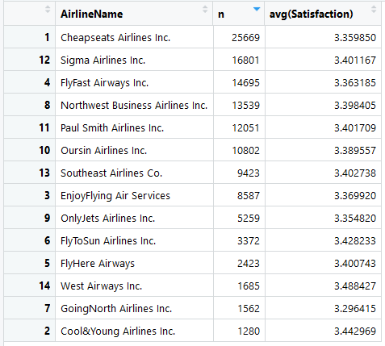
Descriptive Statistics
The data has129,889 rows, each of which corresponds to a customer across 28 variables.

Slide 4
Models used
Throughout this project we have used the following models :
Linear Regression
This model was useful for us to understand the significance of variables and select the ones on which satisfaction depends.
The higher the R-squared value the more significant/correlated it is.
Support Vector Machines
This model was useful for us in further understanding of significant attributes by comparing the error rates of their predictions.
Association Rule Mining
Association Rule Mining helps us find interesting rules that result into higher satisfaction. For example, satisfaction is affected by age(Middle aged passengers tend to give higher satisfaction rating.)

Slide 5
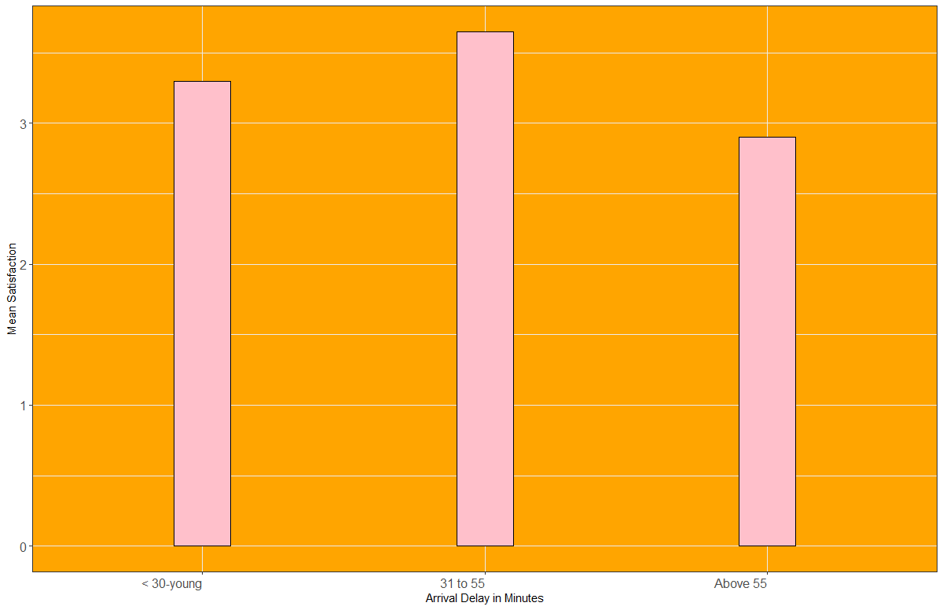
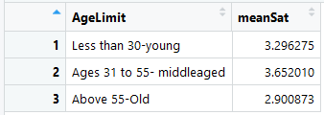
AGE
What we found:
Satisfaction of customer from ages 31 to 55 is higher than other customers.
Customers above the age of 55 have a lower average satisfaction.

Slide 6

Age
Suggestions based on insights:
Add more helping equipment and assistance services for customers older than 55.
Take surveys about what services customers below 30 expect on flights.

Slide 7
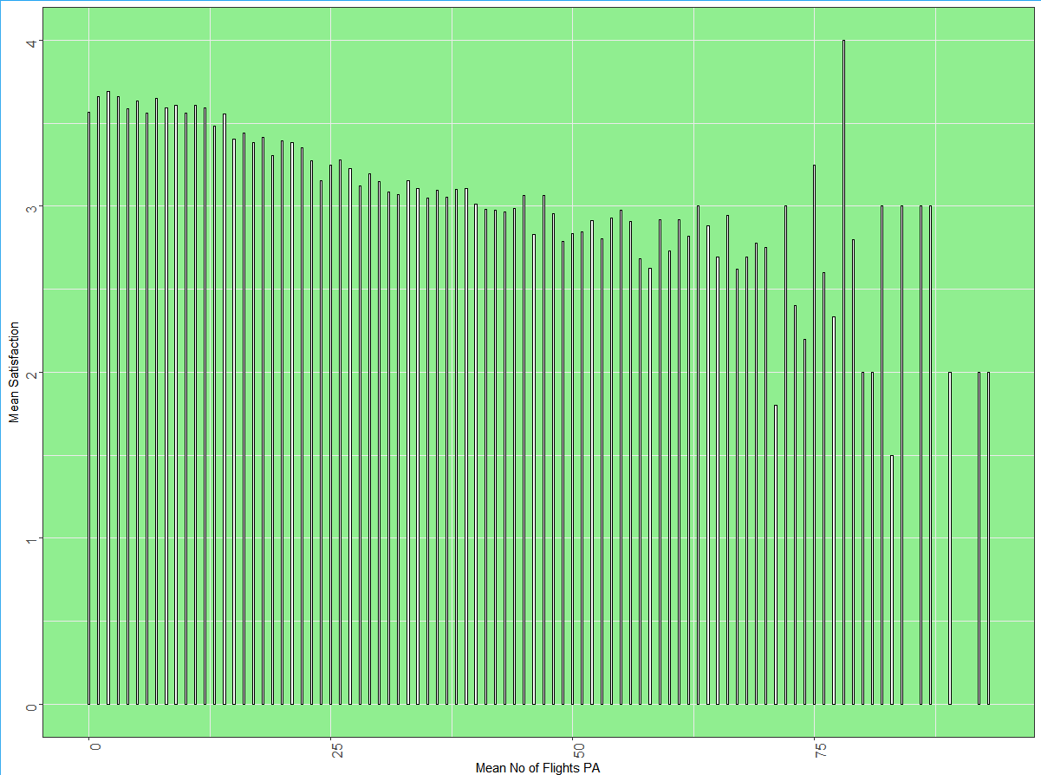
Number of flights in the PAST
What we found:
People who have less than 15 flights give higher satisfaction.
The satisfaction ratings decrease when number of flights in the past increases.

Slide 8
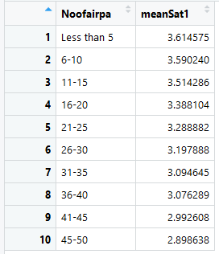
Number of Flights in the Past
Suggestions based on insights:
Add more service options for those customers who have more number of flights in the past.
Give rewards for each flight and allow them to exchange reward points for services.
Improve basic services such as provide better quality food, enable Wi-Fi and enhance entertainment options.

Slide 9
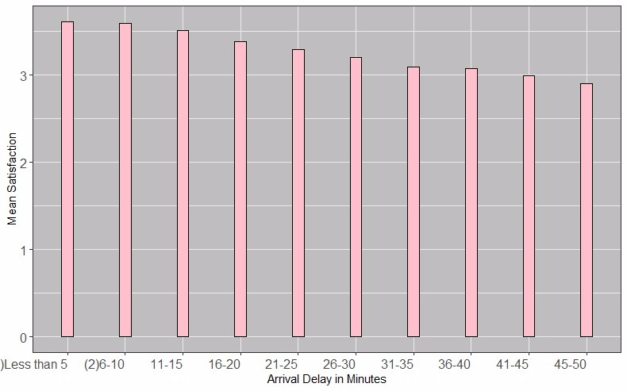
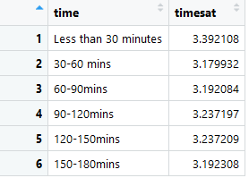
Arrival Delay
What we found:
The delay time in 30 mins people have highest satisfaction.
Satisfaction increase a little bit from 90-150 mins(possibly because airlines try to makeup for the delay)

Slide 10

Arrival Delay
Suggestions based on insights:
The airline should try not to exceed the delay time of 30 minutes.
For uncontrollable factors, such as bad weather, the possible solution for long time delay can be to provide more entertainment around the boarding area of the airline.

Slide 11
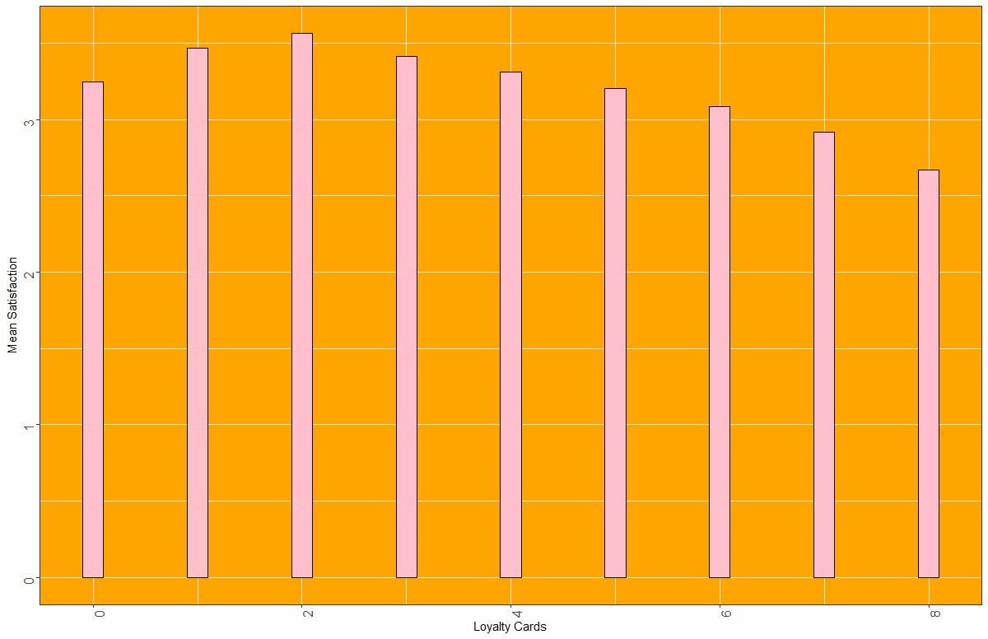
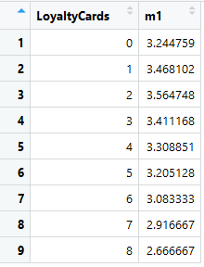
Loyalty cards
What we found:
Satisfaction increase from 0 card to 1,2, and 3 cards per customer
Satisfaction decreases when customers have too many cards

Slide 12
Loyalty cards
Suggestions based on insights:
Give more facilities to people with a loyalty card such as:
Ticket cancellation
Extra baggage
Seat flexibility
Promote loyalty cards by:
Attractive offers on cards- discount offers if you apply card immediately.
If the company is selling loyalty cards at a price, it should reduce the price.

Slide 13
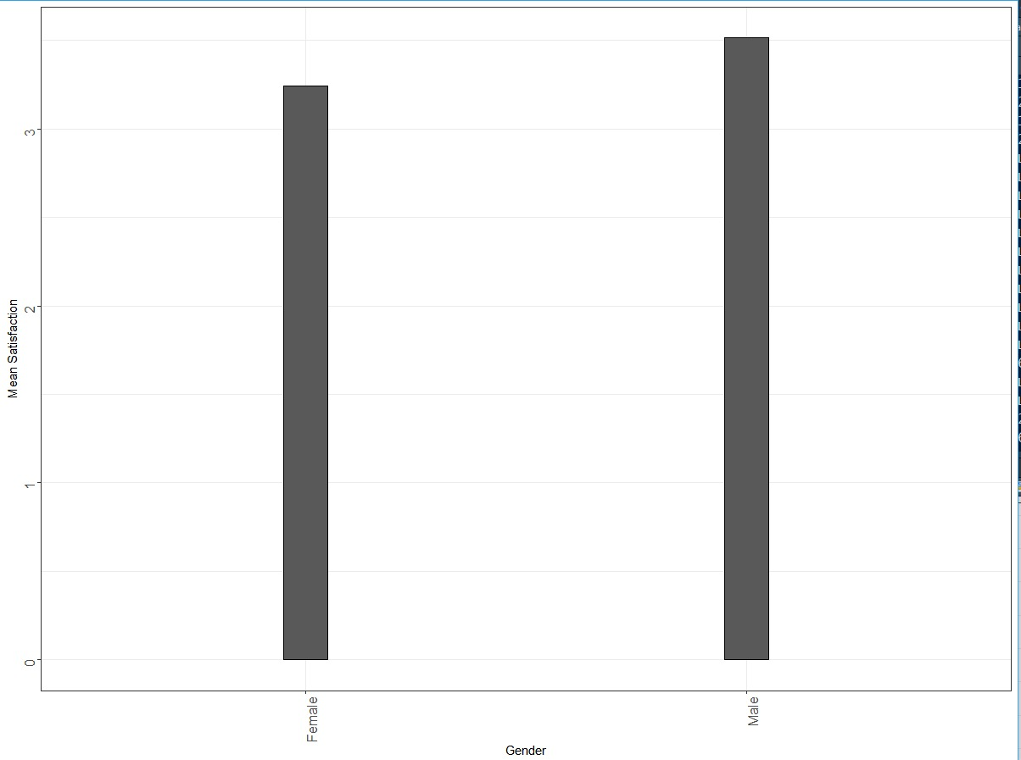

Gender
What we found:
The average satisfaction of female passengers is lower than male passengers.
Suggestions based on insights:
Provide more women-friendly services such as fashion magazine, tampons, breast-feeding stations and diaper changing stations.

Slide 14
Thank you!

